Slide 1
GC – MLAG I
Paul Churchland’s Call for a Paradigm Shift in Cognitive Science
Daniel Ramalho
Philosophy of Language Institute
New University of Lisbon

Slide 2
Origins of Cognitive Science
The “Classical” Symbolic Paradigm: Human cognition is a computational process based on the manipulation of discrete symbols in accordance with a combinatorial syntax.
The only way the brain can generate any one of the infinite set of possible human behavioral outputs is by resorting to recursive computational procedures such as the ones used in arithmetic calculation, by means of which the appropriate output for each specific input emerges as a result of a fixed function composed of a possibly multiple but always limited number of steps.

Slide 3
Universal Turing Machine: a general-purpose, physically realizable discrete-state device capable of implementing any recursive procedure whatsoever.
A Universal Turing Machine can simulate any special-purpose Turing machine, in the same way that a digital computer – given sufficient time, memory and computational power – can run any special-purpose software program (e.g. calculators, flight simulators, chess programs, operative systems, etc.).

Slide 4
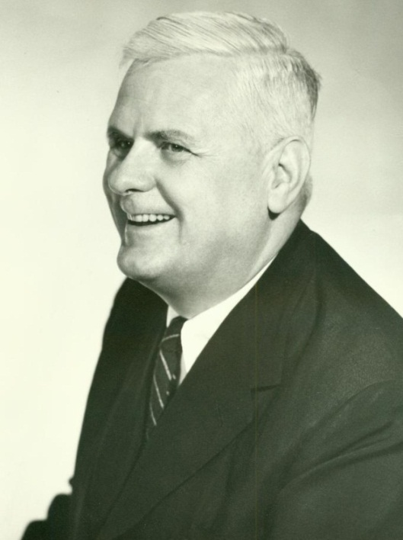
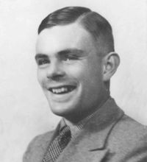
Alonzo Church (1903-1995)
Alan Turing (1912-1954)
Church-Turing Thesis
A Universal Turing Machine is capable, in principle,
of computing any computable function whatsoever.

Slide 5
Functionalism: If every mental state corresponds to a physically instantiated
computational state, then any physical system that sustains the same functional organization and behavioural output can be said to realize the same mental state,
regardless of its material substrate (multiple realizability).
Cognitive psychology is irreducible to lower level sciences such as biology or neurophysiology.
Folk psychology (commonsense conception of cognitive activity, grounded on propositional attitudes such as “I believe/hope/desire that p”) is an approximately accurate depiction of the abstract function that characterizes all human cognitive activity.

Slide 6
The goal of “classical” Artificial Intelligence and Cognitive Psychology: ‘find/write the program that, when run on a universal computer, will recreate the same input-output profile that characterizes a normal human.’ (Churchland, 2006)
Cognitive “Platonic Function”

Slide 7
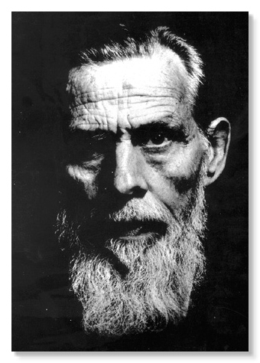
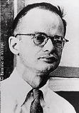
The Connectionist Approach
Warren McCulloch (1898-1969)
Walter Pitts (1923-1969)

Slide 8
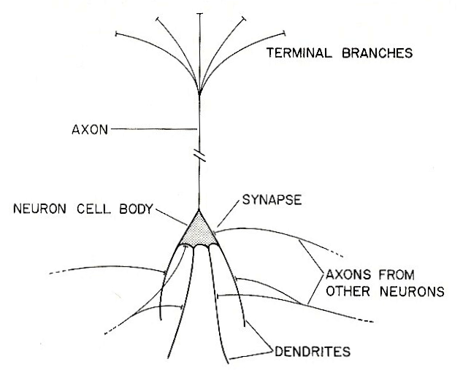
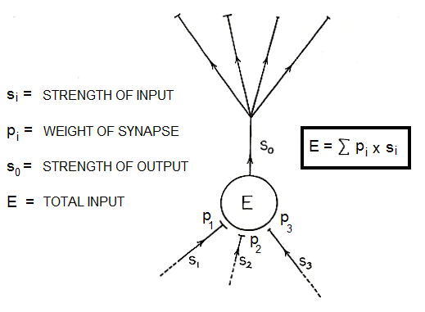
The neuron as the basic computational element
Biological neuron
Artificial neuron

Slide 9
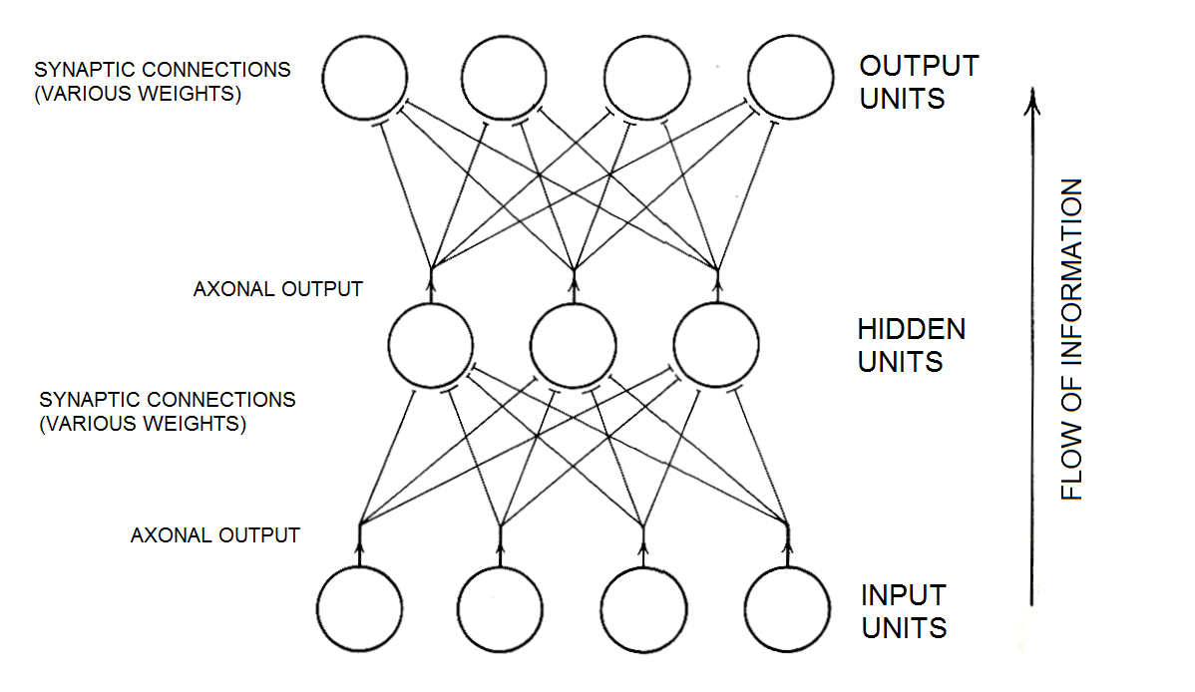
Parallel Distributed Processing
A basic three-layered neural network

Slide 10
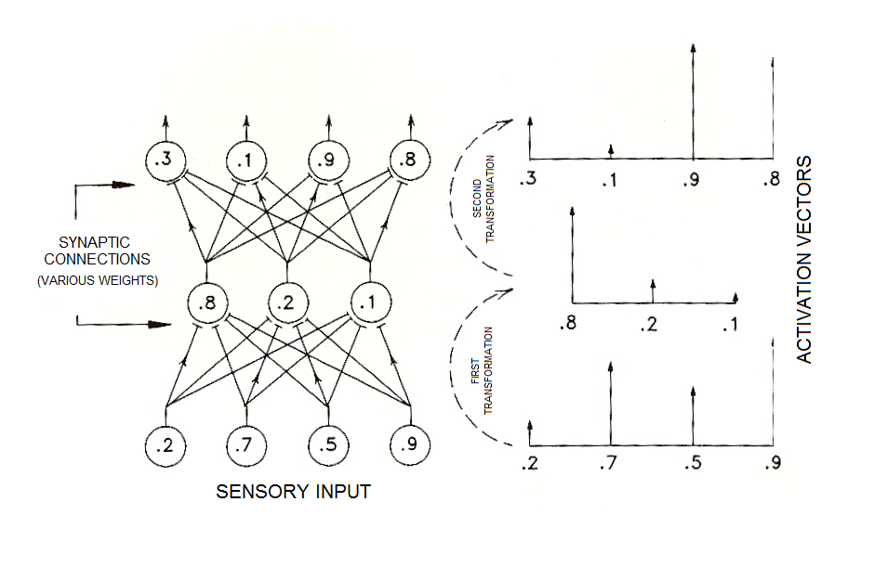
Activation vector transformation

Slide 11
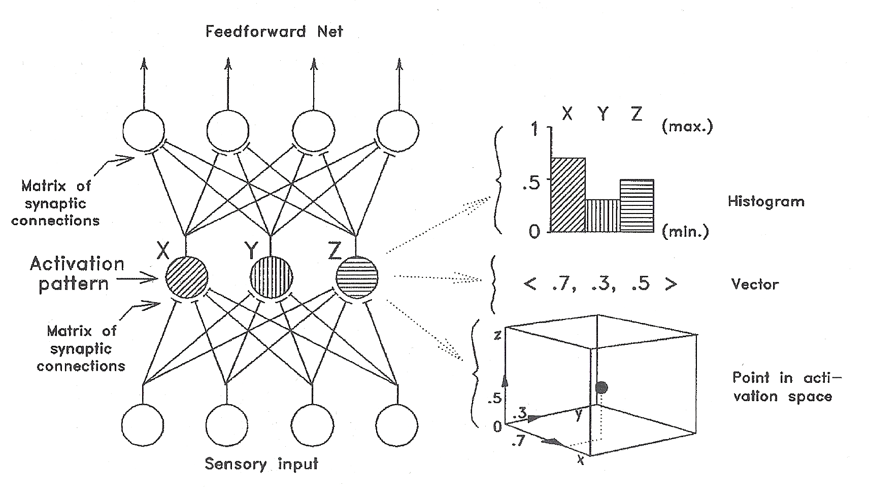
Vector coding in an elementary network

Slide 12
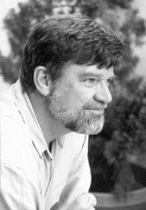
‘The brain is a massively parallel vector processor, […] a nonserial, nondigital computer that transforms high-dimensional input vectors (namely, the pattern of activation-levels across a large population of neurons) into output vectors (patters of activation across a downstream population of neurons), which ultimately control the body’s muscle system.’ (Churchland, 2006)

Slide 13
‘Evidently, the basic mode of singular, ephemeral, here-and-now perceptual representation is not the propositional attitude at all; it is the vectorial attitude. And the basic mode of information processing is not the inference drawn from one propositional attitude to another; it is the synapse induced transformation of one vectorial attitude into another .’ (Churchland, 2001)

Slide 14
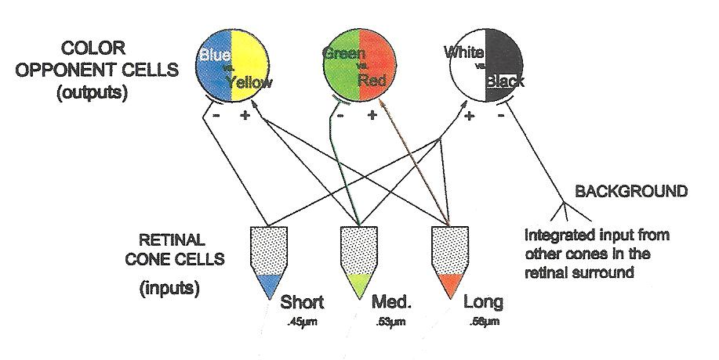
The Hurvich-Jameson network

Slide 15
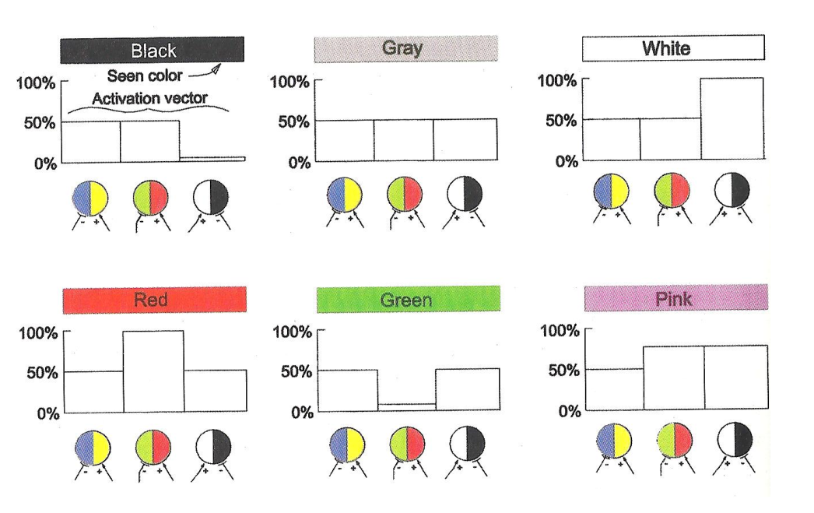
Color coding vectors

Slide 16
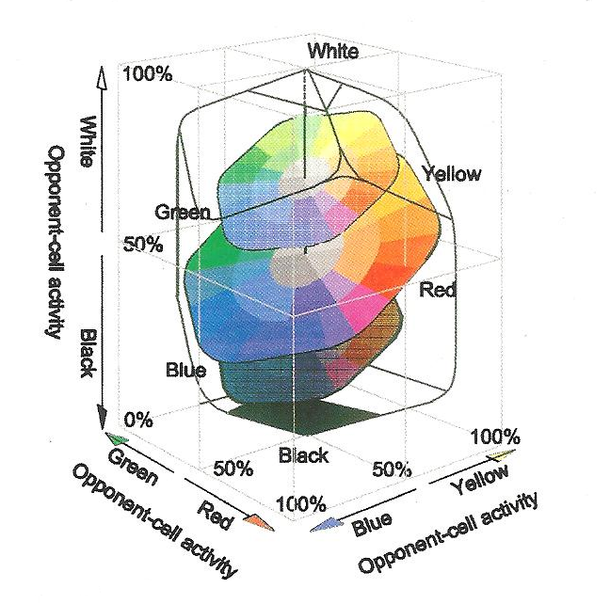
Color coding in the H-J activation space

Slide 17
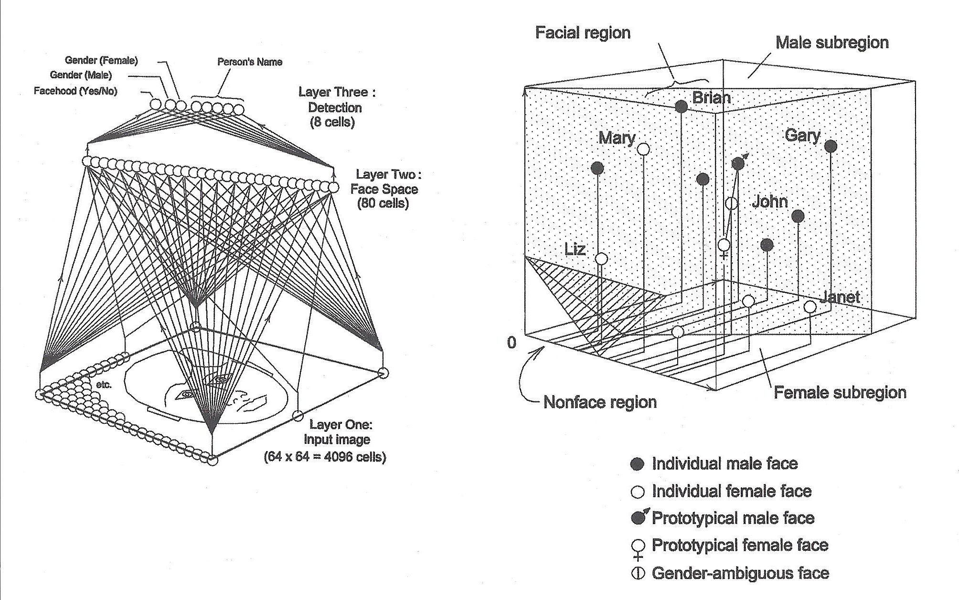
Facial recognition network

Slide 18
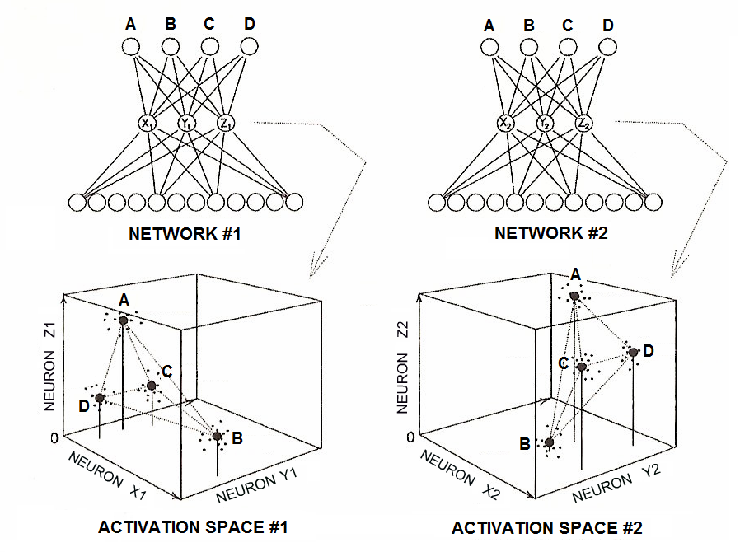
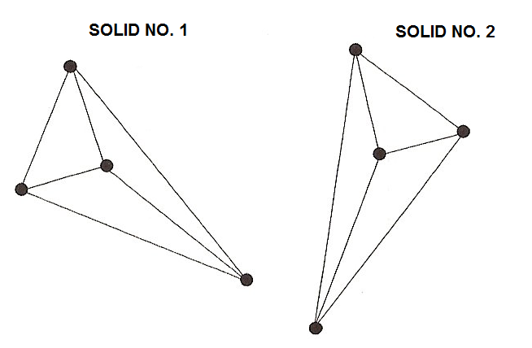
“Domain Portrayal Semantics”
‘A mature mammalian brain, on this view, is the seat of a large family of sculpted activation-spaces, one for each of the brain’s major neuronal populations, and each such space embodies its own intricate family of prototype positions configured by a proprietary set of distance relations. That is what a conceptual framework is.’ (Churchland, 2001)

Slide 19
‘Language use is something that is learned by a brain already capable of vigorous cognitive activity; language use is acquired as only one among a great variety of learned manipulative skills; and it is mastered by a brain that evolution has shaped for a great many functions, language use being only the very latest and perhaps the least of them […]. Why accept, then, a theory of cognitive activity that models its elements on the elements of human language?.’ (Churchland, 1992)

Slide 20
Advantages of Connectionism over the Symbolic Approach:
Biological plausibility
Explanatory parsimony
Computational speed: ‘If the brain were indeed a general-purpose digital serial computer, it would be doomed to be both a computational tortoise and a computational dunce.’ (Churchland, 2006)
Neural networks’ greater resilience to damage (“graceful degradation”)
Neural networks’ greater capacity to accurately categorize partial or degraded sensory input

Slide 21
‘The fact is, no two of us normal humans are computing exactly the same abstract function […]. What unites us, in the end, is our sharing the same basic kinds of computational machinery. That empirical machinery, and the endless forms of articulation it may find in various individuals and in various species, is the true subject of the cognitive sciences. If we seek the essence of our endlessly variable Natural Kind, that is surely where it lies – not in Plato’s Heaven, but inside the head.’ (Churchland, 2006)

Slide 22
References
Churchland, Paul (2006), “On the Nature of Intelligence: Turing, Church, von Neumann, and the Brain”, S. Epstein, ed., A Turing-Testt Sourcebook, ch. 5, MIT Press
Churchland, Paul, (2001), “What Happens to Reliabilism When it is Liberated from the Propositional Attitudes?”, Philosophical Topics, 29, no. 1 and 2: 91-112
Churchland, Paul (2002), “A Neurocomputational Perspective: The Nature of Mind and the Structure of Science”, MIT Press

